Slide 1
Finite State Machines

Slide 2
Outline
How AI fits in
Finite State Machines
Theory
Implementations
Homework #2

Slide 3
AI in the Game Loop
AI is updated as part of the game loop
There are issues here:
Which AI goes first?
Does the AI run on every frame?
Is the AI synchronized?

Slide 4
AI Update Step
The sensing phase determines the state of the world
May be very simple - state changes all come by message
Or complex - figure out what is visible, where your team is, etc
The thinking phase decides what to do given the world
The core of AI
The acting phase tells the animation what to do
Generally not interesting
AI Module
Sensing
Game Engine
Thinking
Acting

Slide 5
AI by Polling
The AI gets called at a fixed rate
Senses: It looks to see what has changed in the world. For instance:
Queries what it can see
Checks to see if its animation has finished running
And then acts on it
Easy to implement, but...

Slide 6
Can be inefficient
AI operations can be slow
Might not need to run all the time

Slide 7
Event Driven AI
Event driven AI does everything in response to events in the world
Events sent by message (basically, a function gets called when a message arrives, just like a user interface)
Example messages:
A certain amount of time has passed, so update yourself
You have heard a sound
Someone has entered your field of view

Slide 8
More typical
A mixture of approaches
Periodic call of some basic sensing
Message-based interrupts
Asychronous calls to more complex functions
like planning
For now
in Buckland’s code
AI will be called every frame
but later in the quarter we’ll mix it up

Slide 9
What is a FSM? (History)
A rigid formalized device to solve math problems
Alan Turing
“A finite state machine is a device or a model of a device, which has a finite number of states it can be in at any given time and can operate on input or either make transitions from one state to another or to cause an output or action to take place. A finite state machine can only be in one state at any moment in time”
In Summary
States
Transitions

Slide 10
What is a FSM? (History)
Examples in Games
Pac-Man
Ghosts
Chase, Flee
FPS
Bots
Chase, Flee, Shoot, GetAmmo, etc.
Sports
FIFA
Strike, Dribble, ChaseBall, Pass, etc.

Slide 11
Finite State Machines (FSMs)
A set of states that the agent can be in
Connected by transitions that are triggered by a change in the world
Normally represented as a directed graph, with the edges labeled with the transition event
Ubiquitous in computer game AI
You might have seen them in theory of computation (or compilers)

Slide 12
Example
moving ahead
facing wall
turn right
done turning
facing door
exit door
END

Slide 13
FSP Bot Example
Types of behavior to capture:
Patrol
Look For Player
Shoot at Player
Look For Cover
Find Health Packs
Find Ammo Packs

Slide 14
How to think about this problem?
Think about the different states the agent will be in
what discrete sets of behaviors go together
Think about conditions
what causes the agent to move between states
Then you can think about relationships
typically in a diagram

Slide 15
States?

Slide 16
Conditions?

Slide 17
Example FSM
States:
E: enemy in sight
S: sound audible
D: dead
Events:
E: see an enemy
S: hear a sound
D: die
Action performed:
On each transition
On each update in some states (e.g. attack)
Attack
E,~D
~E
D
E
E
Wander
~E,~S,~D
S
Chase
S,~E,~D
E
~S
D
~E
Spawn
D
S
D
Notes:
If completely connected – don’t need FSM, could just use a case statement or switch statement.

Slide 18
Typical FSM Problem
States:
E: enemy in sight
S: sound audible
D: dead
Events:
e: see an enemy
s: hear a sound
d: die
Attack
E,~D
~e
d
e
e
Wander
~E,~S,~D
s
Chase
S,~E,~D
e
~s
d
~e
Spawn
D
s
d
Problem: Can’t go directly from attack to chase. Why not?
Notes:
If completely connected – don’t need FSM, could just use a case statement or switch statement.

Slide 19
Better Example FSM
~s
Attack-S
E,S,~D
States:
E: enemy in sight
S: sound audible
D: dead
Events:
e: see an enemy
s: hear a sound
d: die
Extra state to recall whether or not heard a sound while attacking
Attack
E,~S,~D
~e
s
d
d
~e
e
e
Wander
~E,~S,~D
s
Chase
S,~E,~D
e
~s
d
~e
Spawn
D
s
d
Notes:
If completely connected – don’t need FSM, could just use a case statement or switch statement.

Slide 20
Example FSM with Retreat
Attack-ES
E,-D,S,-L
Attack-E
E,-D,-S,-L
S
Retreat-S
-E,-D,S,L
States:
E: enemy in sight
S: sound audible
D: dead
L: Low health
Worst case: Each extra state variable can add 2n extra states
n = number of existing states
-S
L
L
-L
E
-E
E
Wander-L
-E,-D,-S,L
E
-L
Retreat-ES
E,-D,S,L
-L
E
L
-S
-L
L
S
Retreat-E
E,-D,-S,L
Wander
-E,-D,-S,-L
-E
-E
E
D
D
Chase
-E,-D,S,-L
D
D
Spawn
D
(-E,-S,-L)
S

Slide 21
Problem
FSMs do not handle complex behaviors well
there are some hacks
But if you need to take many factors into account
in deciding what to do
FSM is not the right approach
We’ll see behavior trees later

Slide 22
Augmented FSM
Typically, there will be book-keeping to do when transitioning between states
For example
"direction of sound" variable
cleared when sound is absent and changing to "Wander" state
Most FSM implementations allow specification of
update
what to do during each time increment in this state
enter
what to do to start up this activity
exit
what to do to end this activity

Slide 23
Example
Chase
Enter
Play animation "weapon forward"
Play sound "battle cry"
Set heading "direction of sound"
Set speed "run"
Update
Set heading "direction of sound"
Move
Exit
Play animation "hand to ear"
Play sound "Huh?"
Set speed "walk"

Slide 24
Creating an FSM
First step: states
think about states
what are the different behaviors to be shown
what conditions are true in each state
Second: transitions
what events in the world cause the agents to change state
Third: diagram
labeled states and transitions

Slide 25
Demos
World of Warcraft Peon
Create skeleton code
Breakdown states and transitions
States?
Transitions?

Slide 26
Switch Statement FSM
Simple Implementation
Gets messy on larger scales
Brute force approach
See Demo 1
Highlights
One Class: Peon
Update()
Contains one massive switch statement
Each case calls a method which represents the state
Each State Method also runs all transition checks
State Method are contained within the Peon Class

Slide 27
State Pattern FSM (instantiated)
OO Design
Clean, Robust
Opportunity to mix OO patterns
See Demo 2
Highlights
Multiple Classes
Peon
Abstract State class
Multiple PeonStates (inherits from State)
Each State implements an Execute method
Peon contains State variable which can be swapped with new states
Pass the peon object to state every update

Slide 28
State Pattern FSM (instantiated)
Highlights
Cons
Every state change, you must create a new state object
If there are hundreds of peons, then you could have hundreds of allocations each update.

Slide 29
State Pattern FSM (static)
Modified State Pattern
See Demo 3
Highlights
All states are singletons
All peons use the same instance
No allocations!
Create a FSM class (abstract)
Only the owner interacts with the FSM rather it being public to the world.Z
Enter/Exit transitions
Helps encapsulate all behavior in single class rather

Slide 30

Pac-Man
An early arcade game using FSMs for the ghosts

Slide 31
Concurrent State Machine
Imagine we have a TPS Hero with a gun
Third Person Shooter
The currently has a FSM managing its movement
Running, Walking, Jumping, Crouching
This includes input, physics, rendering
Now we must all the states of gun to the FSM
This will explode exponentially
Instead create a separate FSM for the movement and gun(s)

Slide 32
Hierarchical State Machine
Imagine TPS Hero again
Most likely you have states that behave similarly
Standing, walking, running, etc.
This leads to a lot of duplicate code
Standing jump, running jump, walking jump
Better to implement the code once and reuse it across all states
Hierarchical State Machine to the rescue

Slide 33
Hierarchical FSMs
What if there is no simple action for a state?
Expand a state into its own FSM, which explains what to do if in that state
Some events move you around the same level in the hierarchy, some move you up a level
When entering a state, have to choose a state for it’s child in the hierarchy
Set a default, and always go to that
Or, random choice
Depends on the nature of the behavior

Slide 34
Hierarchical FSM Example
Attack
Wander
~E
E
Chase
Pick-up
Powerup
~S
S
Spawn
Start
Turn Right
D
~E
Note: This is not a complete FSM
All links between top level states still exist
Need more states for wander
Go-through
Door

Slide 35
Non-Deterministic FSM (Markov Model)
Adds variety to actions
Have multiple transitions for the same event
Label each with a probability that it will be taken
Randomly choose a transition at run-time
1st order Markov Model: New state only depends on the previous state
Attack
Approach
.3
Aim &
Slide Right
& Shoot
.3
Start
.3
.4
.3
Aim &
Slide Left
& Shoot
.4
Aim &
Jump &
Shoot

Slide 36
Push-down State Machines
Suppose we have some repeated behavior
common to many states
don't want to "forget" what we were doing
Example
change weapon if out of ammo
might want to do this while wandering, chasing, or attacking
if we make this a state
where do we transition after doing it?
Separate “global” state
Transition into this state temporarily
and pop back to original machine

Slide 37
FSM Advantages
Very fast – one array access
think GBA
Expressive enough for simple behaviors or characters that are intended to be “dumb”
Can be compiled into compact data structure
Dynamic memory: current state
Static memory: state diagram – array implementation
1000 agents? Still need only to store current state for each agent
Can create tools so non-programmer can build behavior
Non-deterministic FSM can make behavior unpredictable

Slide 38
FSM Disadvantages
Number of states can grow very fast
Exponentially with number of events: s=2e
Number of arcs can grow even faster: a=s²
Limited representational power
Propositional representation

Slide 39
Varieties of representation
Propositional logic:
Statements about specific objects in the world – no variables
Jim is in room7, Jim has rocketLauncher5, rocketLauncher5 does splash damage
Go to room8 if you are in room7 through door14
Predicate Logic:
Allows general statement – using variables
All rooms have doors
All splash damage weapons can be used around corners
All rocket launchers do splash damage
Go to a room connected to the current room

Slide 40
Representation in FSMs
Can only handle propositions
each transition predicated on a proposition being true or false
Difficult to add comparative tests
“pick up the better powerup”
“attack the closest enemy”
Expensive to count
Wait until the third time I see enemy, then attack
Need extra events: First time seen, second time seen, and extra states to take care of counting

Slide 41
Problem
The next step beyond FSM
simple planning or behavior trees
a lot more complicated
So FSMs tend to dominate
esp. in games where AI isn’t the focus

Slide 42
Implementations
switch statement
we can implement a FSM with a switch statement
Each state is a branch
switch (agent_state) {
case CHASE:
if ENEMY state = ATTACK
else if ~SOUND state = WANDER
else DoChase()
case WANDER:
etc.
Concise
but a maintenance nightmare

Slide 43
Table Implementation
event
Compile into an array of state-name, event
state-name_{i+1} := array[state-name_{i}, event]
Switch on state-name to call execution logic
Hierarchical
Create array for every FSM
Have stack of states
Classify events according to stack
Update state which is sensitive to current event
Markov: Have array of possible transitions for every (state-name,event) pair, and choose one at random
state

Slide 44
Transition table
For each state and event
record next
State | Event | NewState | UpdateFn
Chase | Enemy | Attack | DoChase()
Chase | ~Sound | Wander | DoChase()

Slide 45
OO Implementation
States as objects
Actions as methods
State machine can be very generic

Slide 46
Buckland
Uses the "State" design pattern
all information relative to an object's state is encapsulated
changing state is a matter of changing this object
Calling sequence
Game -> Object "update yourself"
Object -> State "update me"
many advantages
state objects can be shared without duplicating code
easy to store "previous state" information

Slide 47
Overall design
Game-wide state machine
When each object is updated,
the state is loaded into the machine and processed
new state is recorded with object
Assumes that everything in the game uses a state machine

Slide 48
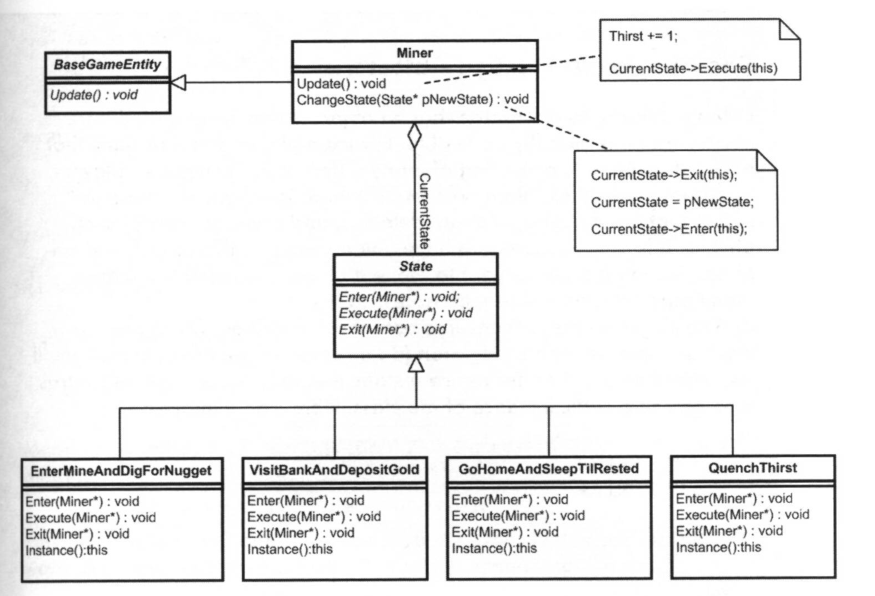
Structure view

Slide 49
Singleton pattern
All states are unique instances
only a single copy of the "Quench Thirst" state
Benefit
no dynamic allocation and destruction of state objects
Drawback
no object-specific information can be stored in the state
Technique
use static allocation
use a static member function that always returns this instance
make constructor private

Slide 50
Example
class QuenchThirst : public State<Miner>
{
private:
QuenchThirst(){}
QuenchThirst(const QuenchThirst&);
QuenchThirst& operator=(const QuenchThirst&);
public:
static QuenchThirst* Instance();
virtual void Enter(Miner* miner);
virtual void Execute(Miner* miner);
virtual void Exit(Miner* miner);
};
QuenchThirst* QuenchThirst::Instance()
{
static QuenchThirst instance;
return &instance;
}

